Slide 1
Local Asymptotic Normality
GwangWoo Kim
August 25, 2021

Slide 2
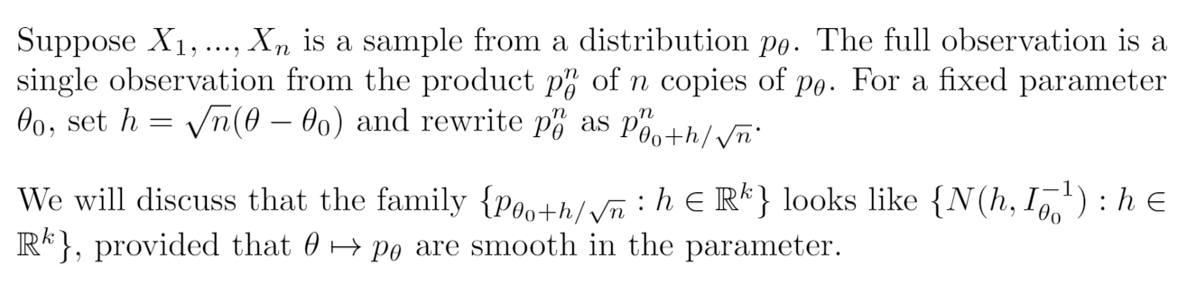
Introduction

Slide 3
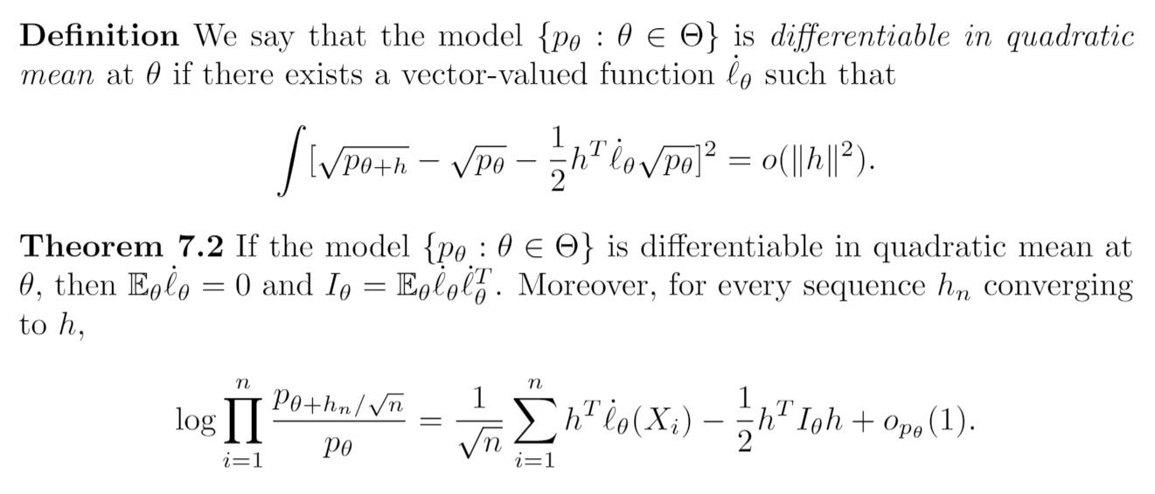
Theorem 7.2

Slide 4
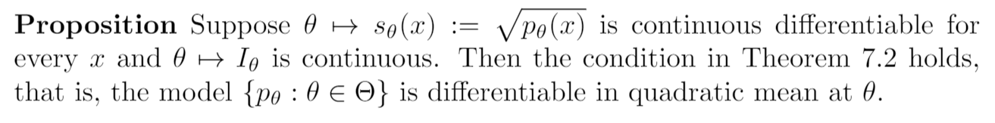
Differentiability in quadratic mean

Slide 5
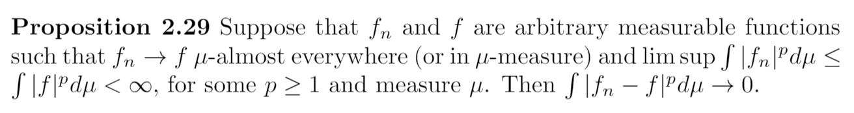
Differentiability in quadratic mean

Slide 6
Examples

Slide 7
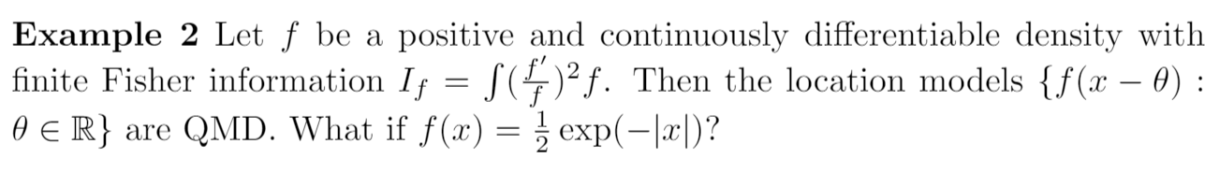
Examples

Slide 8
Examples

Slide 9
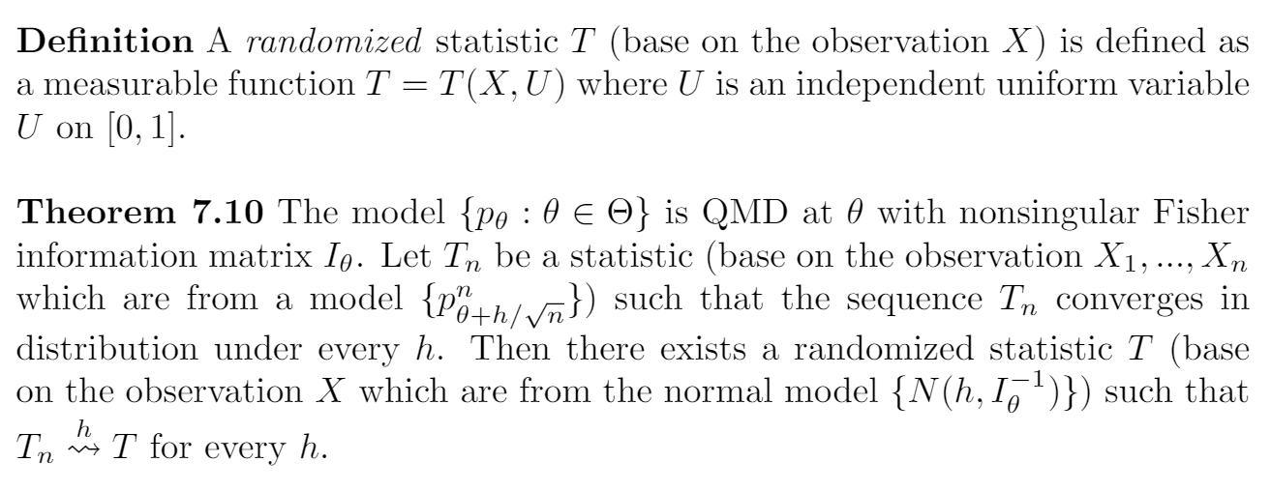
Theorem 7.10

Slide 10
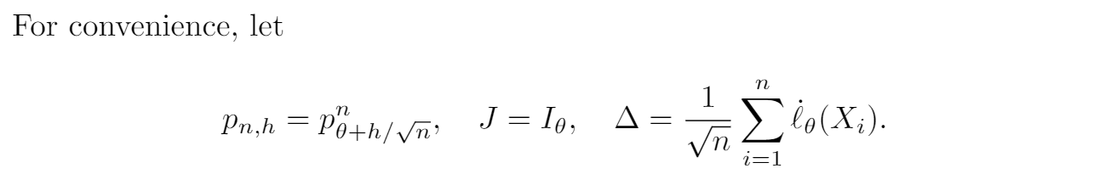
Theorem 7.10

Slide 11
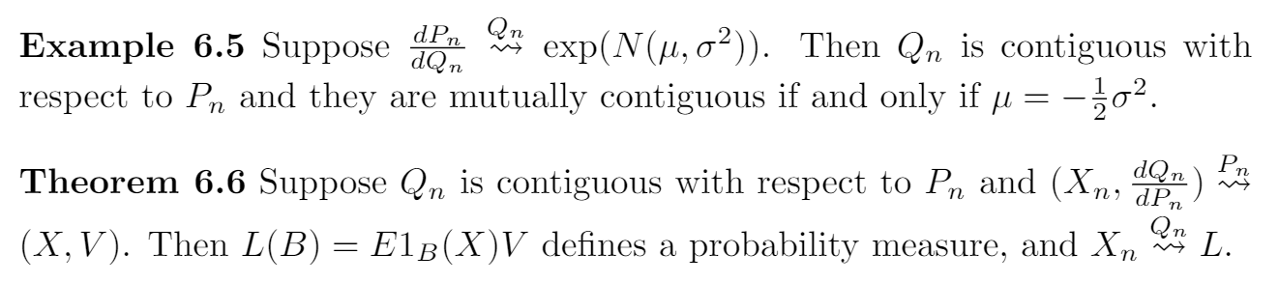

Slide 12
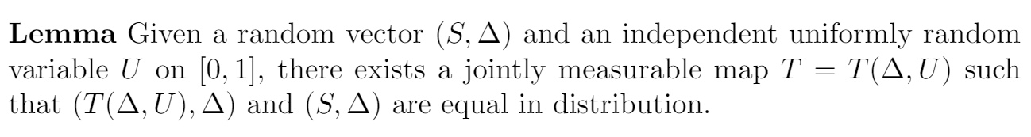
Theorem 7.10

Slide 13
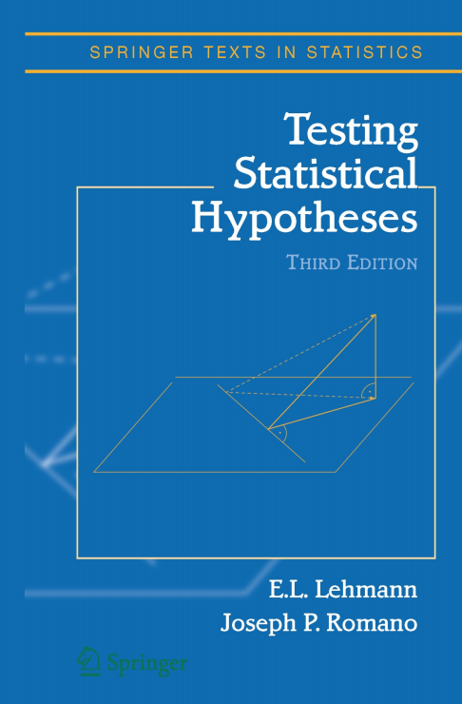
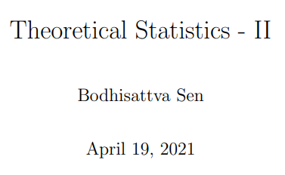
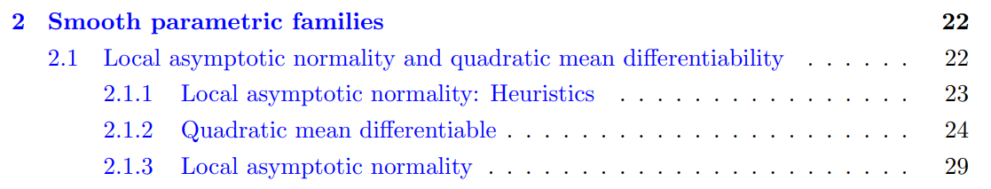
Acknowledgement

